Slide 1

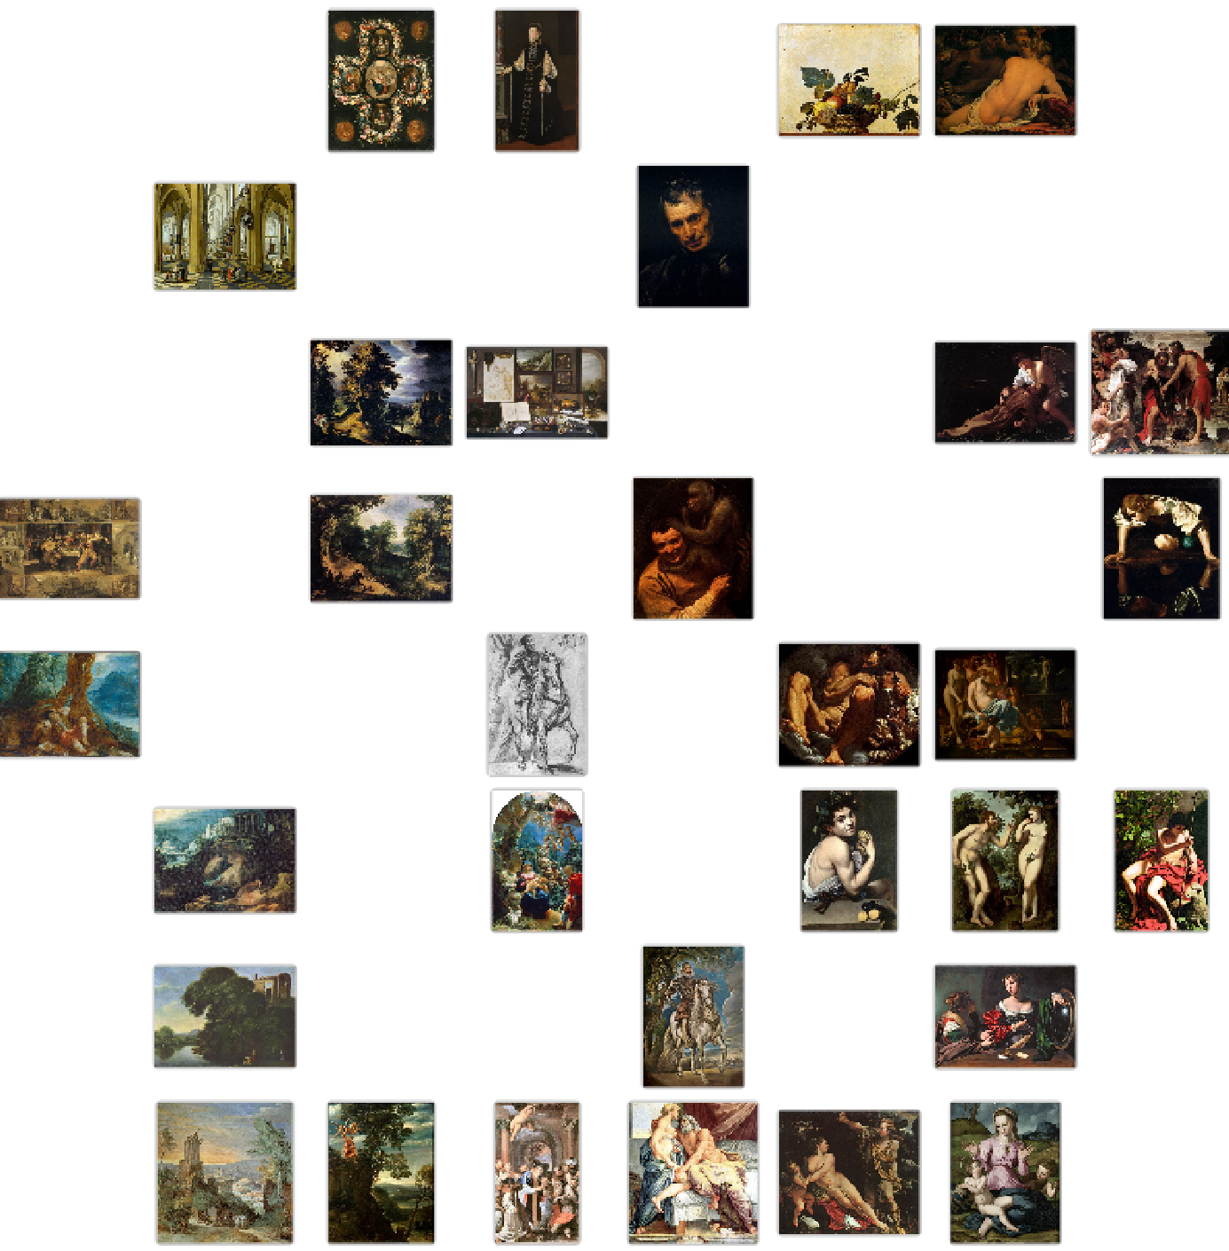
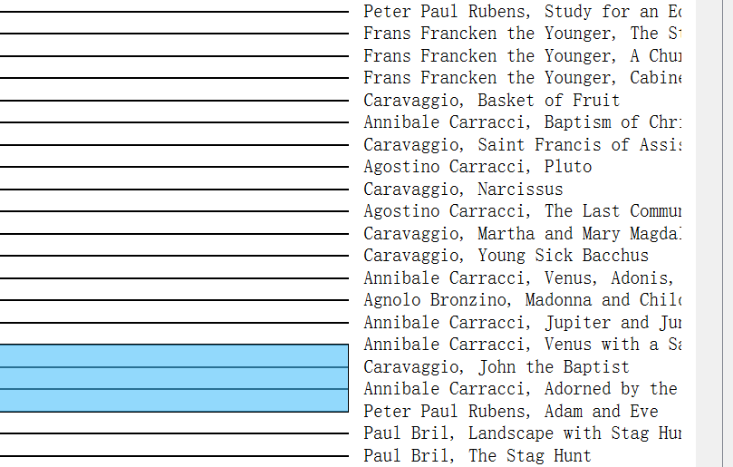
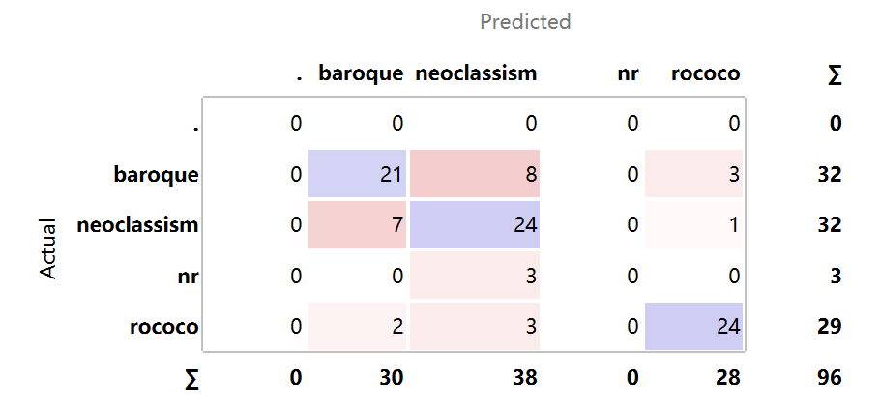
Does AI Know a Piece of Artwork Better Than You?
Zhifei (Maggie) Li
Class of 2026
Exploring Orange tool’s performance in clustering and classifying paintings of Baroque, Rococo and Neoclassicism styles
1️⃣ Baroque Paintings Clustering
2️⃣ Baroque Artists Recognition
✅ Yes It Does:
1-Paintings of Baroque style clustered in a reasonable way
3-Generally able to classify a painting into given styles
❌ No It Doesn’t:
2-Wasn’t really able to distinguish painters
4-Limited automation: my artwork classified as a piece of Baroque style art
🔍 Conclusion:
It has been a great new technology; yet, we need to treat it more skeptically…
3️⃣ Painting Style Prediction
4️⃣ Bonus: Classifying My Artwork into One of the Styles 🤔
IM-UH 1511 Introduction to Digital Arts and Humanities | Spring 2023 | https://bbqmagpie.github.io/blog/image/

